Slide 1
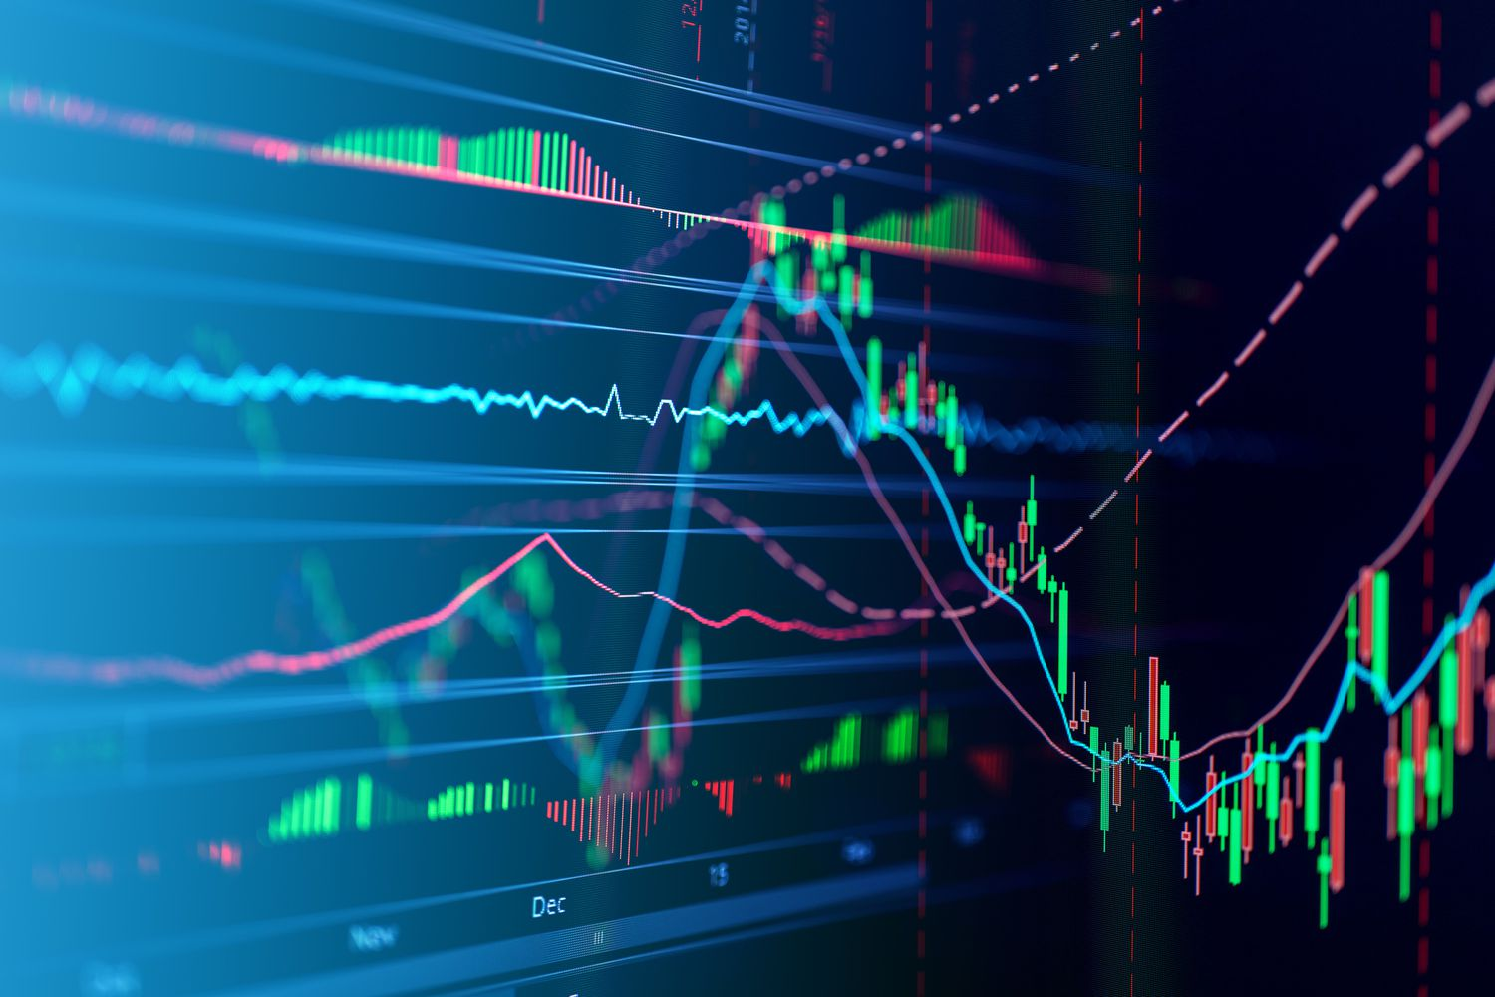
Stock Market Day-Trading with Q-Learning and DQN

Slide 2
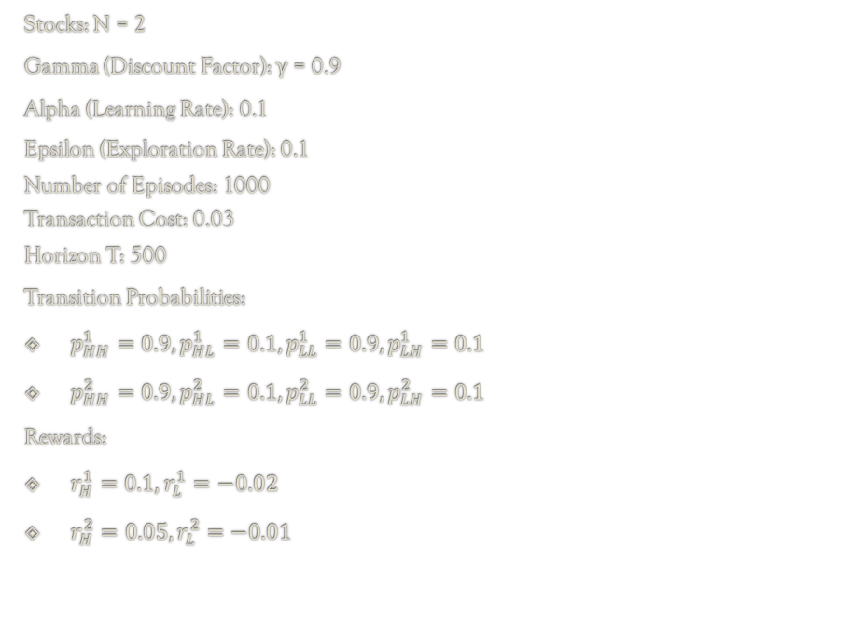
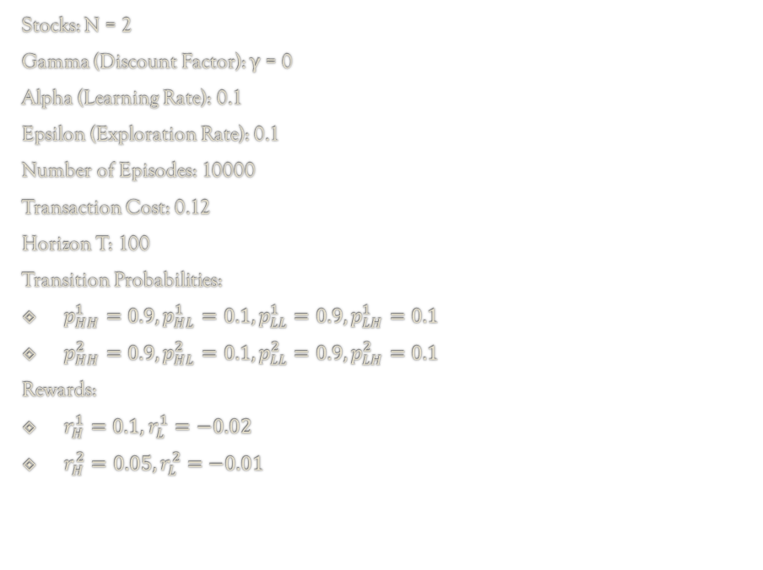
Task 1: Q-Learning on some “toy” scenarios
Scenario from Assignment 3 - Question 1
Scenario from Assignment 3 - Question 2
Stocks: N = 2
Gamma (Discount Factor): γ = 0
Alpha (Learning Rate): 0.1
Epsilon (Exploration Rate): 0.1
Number of Episodes: 10000
Transaction Cost: 0.12
Horizon T: 100
Transition Probabilities:
$p_{HH}^{1}=0.9,p_{HL}^{1}=0.1,p_{LL}^{1}=0.9,p_{LH}^{1}=0.1$
$p_{HH}^{2}=0.9,p_{HL}^{2}=0.1,p_{LL}^{2}=0.9,p_{LH}^{2}=0.1$
Rewards:
$r_{H}^{1}=0.1,r_{L}^{1}=−0.02$
$r_{H}^{2}=0.05,r_{L}^{2}=−0.01$
Stocks: N = 2
Gamma (Discount Factor): γ = 0.9
Alpha (Learning Rate): 0.1
Epsilon (Exploration Rate): 0.1
Number of Episodes: 1000
Transaction Cost: 0.03
Horizon T: 500
Transition Probabilities:
$p_{HH}^{1}=0.9,p_{HL}^{1}=0.1,p_{LL}^{1}=0.9,p_{LH}^{1}=0.1$
$p_{HH}^{2}=0.9,p_{HL}^{2}=0.1,p_{LL}^{2}=0.9,p_{LH}^{2}=0.1$
Rewards:
$r_{H}^{1}=0.1,r_{L}^{1}=−0.02$
$r_{H}^{2}=0.05,r_{L}^{2}=−0.01$

Slide 3
Task 1: Q-Learning on some “toy” scenarios (Results)
Scenario from Assignment 3 - Question 1
Scenario from Assignment 3 - Question 2
Policy Iteration:
Q-Learning:
Policy Iteration:
Q-Learning:
State | Optimal Action | State Value
(1, ’H’, ’H’) | keep | 0.1000
(1, ’H’, ’L’) | keep | 0.1000
(1, ’L’, ’H’) | keep | -0.0200
(1, ’L’, ’L’) | keep | -0.0200
(2, ’H’, ’H’) | keep | 0.0500
(2, ’H’, ’L’) | keep | -0.0100
(2, ’L’, ’H’) | keep | 0.0500
(2, ’L’, ’L’) | keep | -0.0100
State | Optimal Action | State Value
(1, ’H’, ’H’) | keep | 0.1000
(1, ’H’, ’L’) | keep | 0.1000
(1, ’L’, ’H’) | keep | -0.0200
(1, ’L’, ’L’) | keep | -0.0200
(2, ’H’, ’H’) | keep | 0.0500
(2, ’H’, ’L’) | keep | -0.0100
(2, ’L’, ’H’) | keep | 0.0500
(2, ’L’, ’L’) | keep | -0.0100
State | Optimal Action | State Value
(1, ’H’, ’H’) | keep | 0.8988
(1, ’H’, ’L’) | keep | 0.8920
(1, ’L’, ’H’) | switch | 0.7863
(1, ’L’, ’L’) | keep | 0.7720
(2, ’H’, ’H’) | switch | 0.8688
(2, ’H’, ’L’) | switch | 0.8620
(2, ’L’, ’H’) | keep | 0.8163
(2, ’L’, ’L’) | keep | 0.7563
State | Optimal Action | State Value
(1, ’H’, ’H’) | keep | 0.7080
(1, ’H’, ’L’) | keep | 0.6520
(1, ’L’, ’H’) | switch | 0.3990
(1, ’L’, ’L’) | switch | 0.2834
(2, ’H’, ’H’) | switch | 0.6498
(2, ’H’, ’L’) | switch | 0.5415
(2, ’L’, ’H’) | keep | 0.5241
(2, ’L’, ’L’) | keep | 0.3317
As expected, both algorithms converge to the same optimal actions and Values for each State
Here we observe that the Q-Learning algorithm chooses almost always the same policy as the PI algorithm for each state. What is interesting is that there is a significant divergence between the State Values of the 2 algorithms. This could be possibly fine-tuned by picking proper epsilon, alpha.

Slide 4
Task 2: Q-Learning on a large scenario
Transition probabilities and rewards:
(This is a randomly generated scenario, that we used as a point of reference for Task 2 and Task 3)
Setup:
Stocks: N = 8
Gamma (Discount Factor): γ = 0.99
Alpha (Learning Rate): 0.1
Epsilon (Exploration Rate): 0.1
Number of Episodes: 15000
Transaction Cost: 0.1
Horizon T: 10000
Stock | p_HH | p_LH | p_LL | p_HL | r_H | r_L
0 | 0.9 | 0.1 | 0.9 | 0.1 | 0.018229 | 0.057893
1 | 0.9 | 0.1 | 0.9 | 0.1 | -0.01533 | -0.00484
2 | 0.9 | 0.1 | 0.9 | 0.1 | 0.00551 | -0.01366
3 | 0.9 | 0.1 | 0.9 | 0.1 | 0.054678 | 0.065431
4 | 0.5 | 0.5 | 0.5 | 0.5 | -0.01422 | -0.00018
5 | 0.5 | 0.5 | 0.5 | 0.5 | -0.01767 | -0.01289
6 | 0.5 | 0.5 | 0.5 | 0.5 | 0.087307 | 0.006854
7 | 0.5 | 0.5 | 0.5 | 0.5 | 0.070127 | 0.065792
Spoiler: Stock 7 is a favorite

Slide 5
Task 2: Q-Learning on a large scenario (Results)
Policy Iteration:
Q-Learning:
State | Optimal Action | State Value
(0,(’H’, ’H’, ’H’, ’H’, ’H’, ’H’, ’H’, ’H’)) | Stock 7 | 6.6981
(0, (’H’, ’H’, ’H’, ’H’, ’H’, ’H’, ’H’, ’L’)) | Stock 7 | 6.6937
(0, (’H’, ’H’, ’H’, ’H’, ’H’, ’H’, ’L’, ’H’)) | Stock 7 | 6.6981
(0, (’H’, ’H’, ’H’, ’H’, ’H’, ’H’, ’L’, ’L’)) | Stock 7 | 6.6937
(0, (’H’, ’H’, ’H’, ’H’, ’H’, ’L’, ’H’, ’H’)) | Stock 7 | 6.6981
(0, (’H’, ’H’, ’H’, ’H’, ’H’, ’L’, ’H’, ’L’)) | Stock 7 | 6.6937
(0, (’H’, ’H’, ’H’, ’H’, ’H’, ’L’, ’L’, ’H’)) | Stock 7 | 6.6981
(0, (’H’, ’H’, ’H’, ’H’, ’H’, ’L’, ’L’, ’L’)) | Stock 7 | 6.6937
(0, (’H’, ’H’, ’H’, ’H’, ’L’, ’H’, ’H’, ’H’)) | Stock 7 | 6.6981
State | Optimal Action | State Value
(0,(’H’, ’H’, ’H’, ’H’, ’H’, ’H’, ’H’, ’H’)) | Stock 7 | 6.6972
(0, (’H’, ’H’, ’H’, ’H’, ’H’, ’H’, ’H’, ’L’)) | Stock 7 | 6.6936
(0, (’H’, ’H’, ’H’, ’H’, ’H’, ’H’, ’L’, ’H’)) | Stock 7 | 6.6986
(0, (’H’, ’H’, ’H’, ’H’, ’H’, ’H’, ’L’, ’L’)) | Stock 7 | 6.6942
(0, (’H’, ’H’, ’H’, ’H’, ’H’, ’L’, ’H’, ’H’)) | Stock 7 | 6.6986
(0, (’H’, ’H’, ’H’, ’H’, ’H’, ’L’, ’H’, ’L’)) | Stock 7 | 6.6941
(0, (’H’, ’H’, ’H’, ’H’, ’H’, ’L’, ’L’, ’H’)) | Stock 7 | 6.6987
(0, (’H’, ’H’, ’H’, ’H’, ’H’, ’L’, ’L’, ’L’)) | Stock 7 | 6.6934
(0, (’H’, ’H’, ’H’, ’H’, ’L’, ’H’, ’H’, ’H’)) | Stock 7 | 6.6979
From the results we can see that our Q-Learning algorithm converges to the same actions, and the same state values with a pretty high accuracy (0.001 divergence)

Slide 6
Task 3: DQN (Architecture)
Input Layer: Receives a tensor representing the continuous yield values of the stocks (size equal to the number of stocks).
2 Hidden Layers: Fully connected, with 64 neurons, using ReLU for activation
Output Layer: Fully connected with the number of neurons equal to the number of actions (e.g the number of stocks). Outputs a Q Value for every possible action.
Why this input?
Because the vectors with the yield values for each stock are crucial in order to make informed investment decisions.
Why this output?
Because we need the Q values to estimate the most rewarding future states (in our case the stocks).

Slide 7
Task 3: DQN (Setup)
Transition probabilities and rewards:
(This is a randomly generated scenario, that we used as a point of reference for Task 2 and Task 3)
Setup:
Stocks: N = 8
Gamma (Discount Factor): γ = 0.99
Learning Rate: 0.001
Epsilon (Exploration Rate): Starting from 1, multiplying itself by 0.995 at the end of every episode so that it decays over time
Number of Episodes: 1000
Transaction Cost: 0.1
Horizon T: 100
Batch Size: 32
Stock | p_HH | p_LH | p_LL | p_HL | r_H | r_L
0 | 0.9 | 0.1 | 0.9 | 0.1 | 0.018229 | 0.057893
1 | 0.9 | 0.1 | 0.9 | 0.1 | -0.01533 | -0.00484
2 | 0.9 | 0.1 | 0.9 | 0.1 | 0.00551 | -0.01366
3 | 0.9 | 0.1 | 0.9 | 0.1 | 0.054678 | 0.065431
4 | 0.5 | 0.5 | 0.5 | 0.5 | -0.01422 | -0.00018
5 | 0.5 | 0.5 | 0.5 | 0.5 | -0.01767 | -0.01289
6 | 0.5 | 0.5 | 0.5 | 0.5 | 0.087307 | 0.006854
7 | 0.5 | 0.5 | 0.5 | 0.5 | 0.070127 | 0.065792
Spoiler: Stock 7 is a favorite

Slide 8
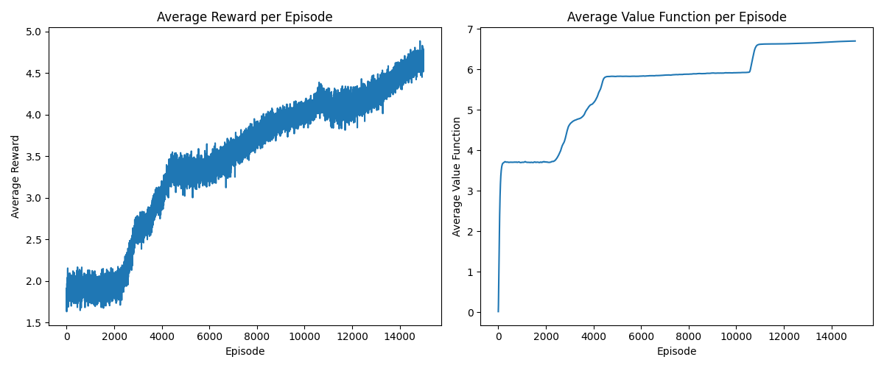
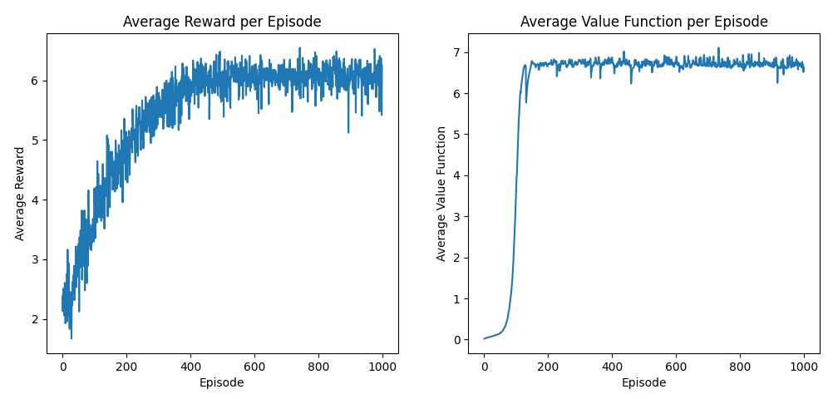
Task 3: Q-Learning vs. DQN (Results)
For comparison, we are going to plot the average reward and average Q per episode (Using the previously stated env).
Q-Learning
DQN
We observe that our DQN converges to almost the same average reward and Q as the Q-Learning algorithm. The
big difference is that our DQN managed to converge way faster than the Q-Learning algorithm (15 times smaller episode
number, smaller horizon)

Slide 9
Thank you for your attention!

